Slide 1
Texas A&M Smart Connected Home Testbed (TAM-SCHT) CFD Test
Mingjun Wei
Zhiyao Yang
Zheng O’Neill
Mechanical Engineering
Texas A&M University
04/30/2024

Slide 2
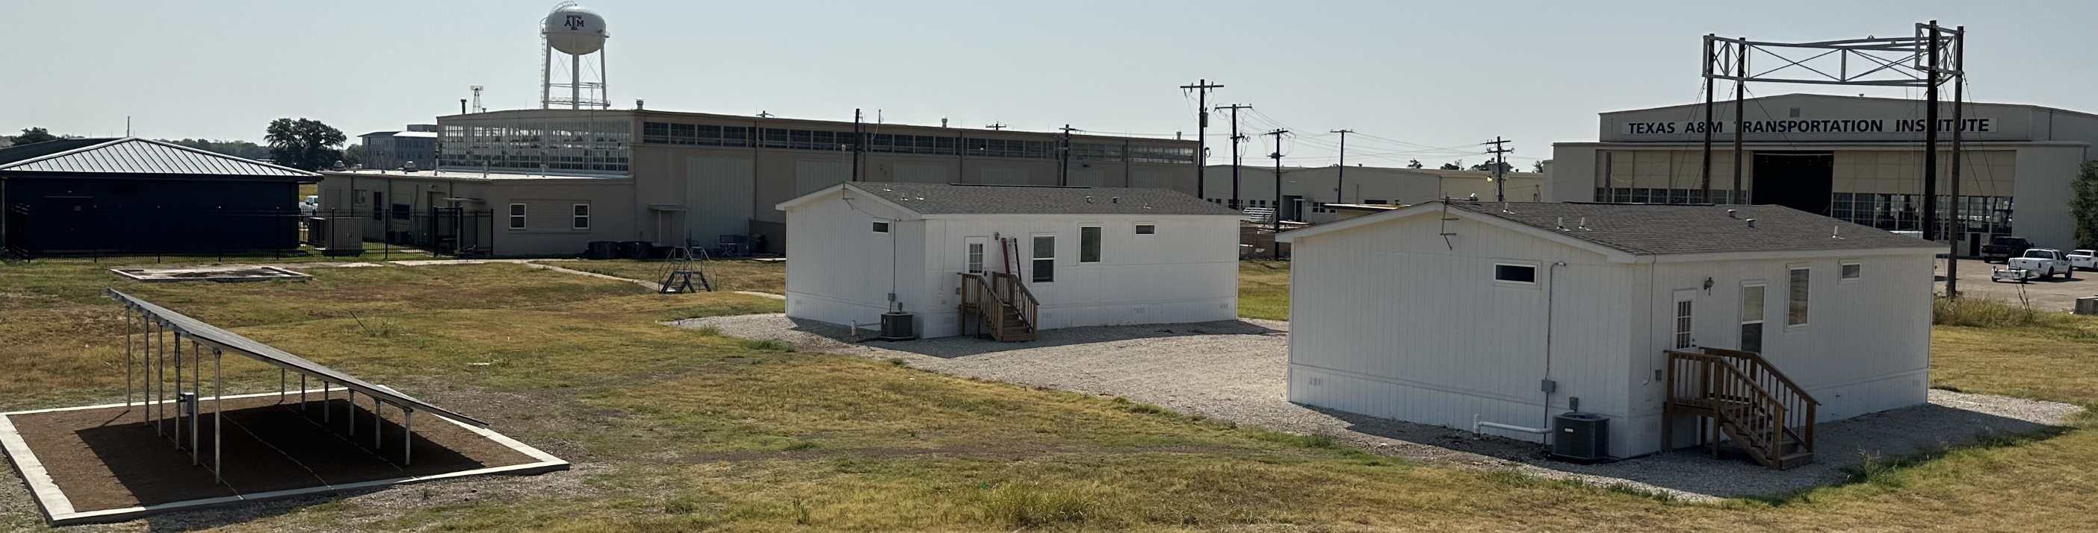
TAM-SCHT
Testing Period: 04/11/2024 – 04/12/2024
Location: College Station, TX
Cooling season

Slide 3
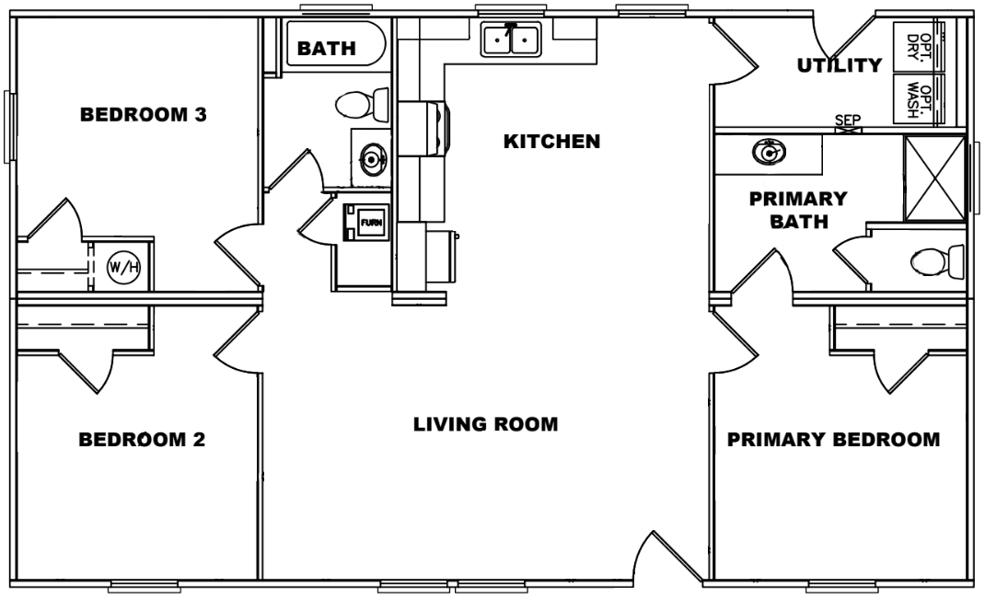
Floor Plan

Slide 4
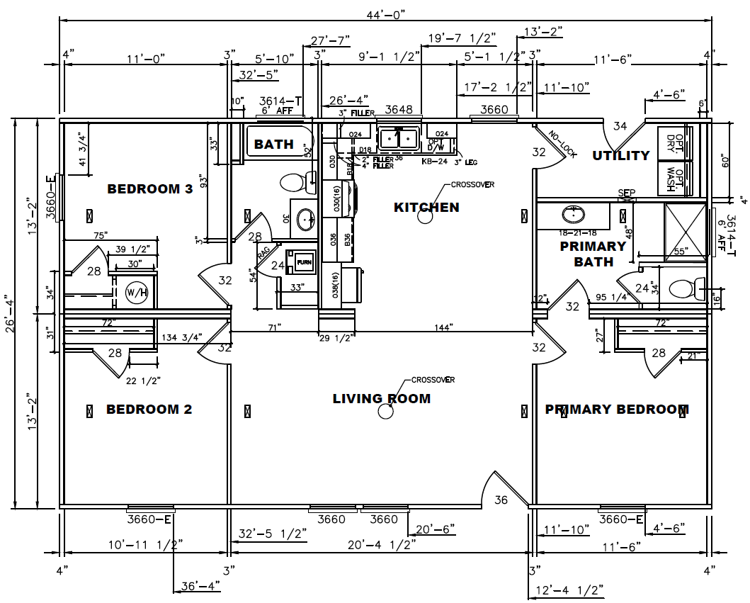
Lab home dimension

Slide 5
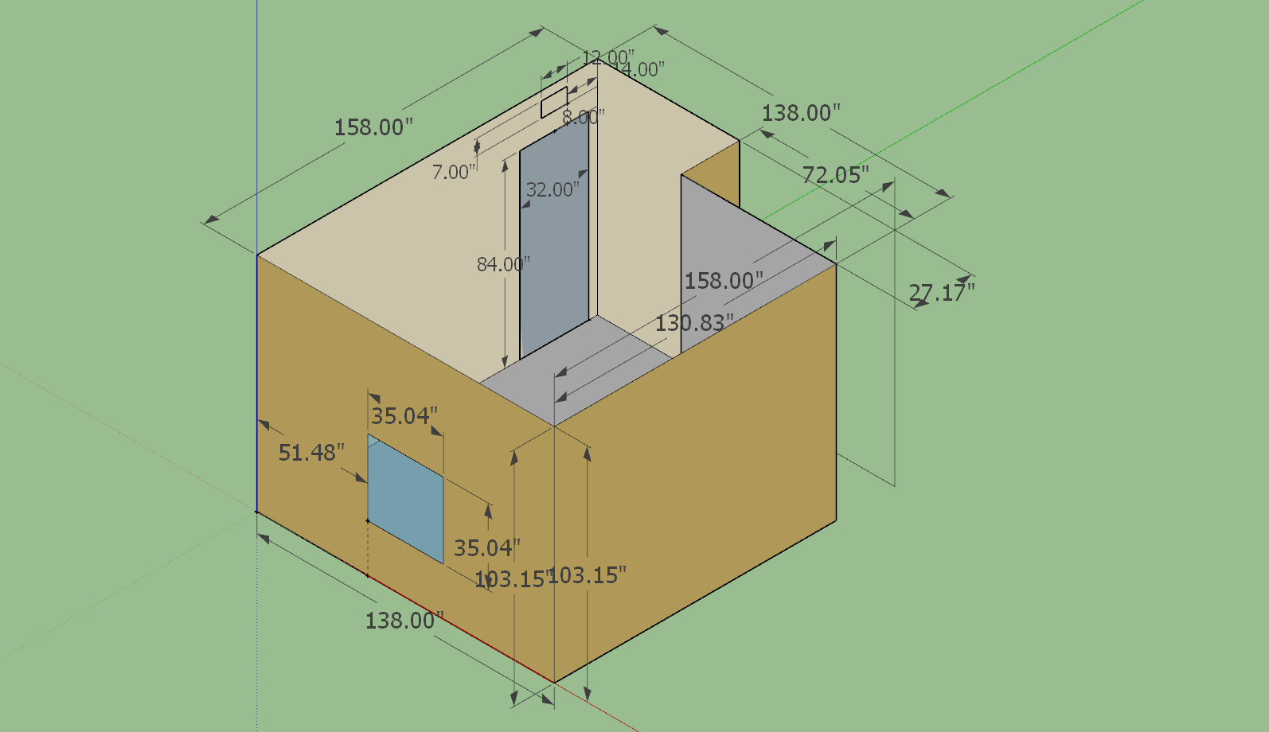
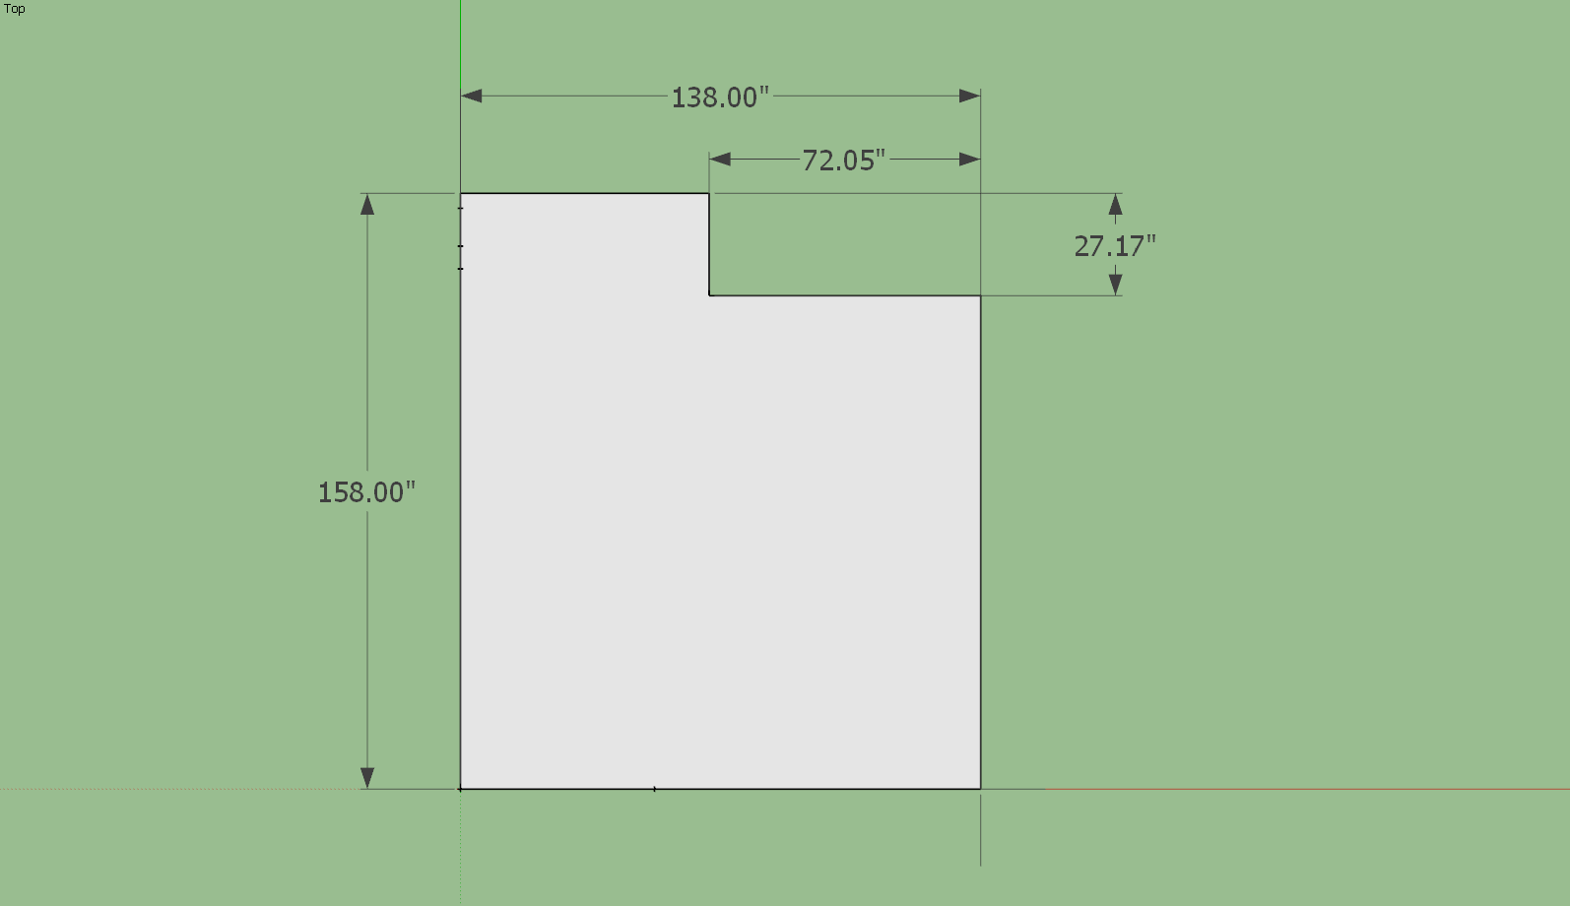
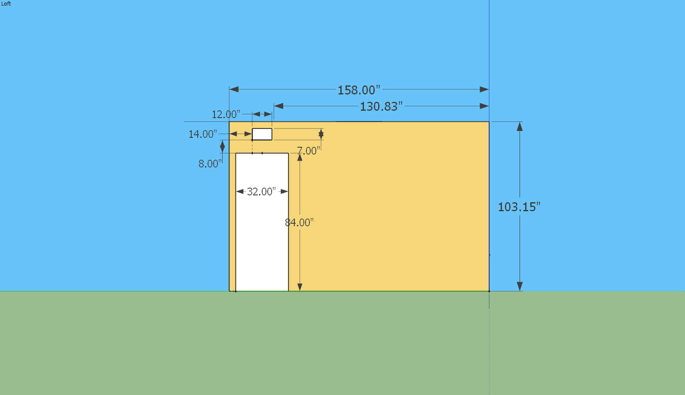
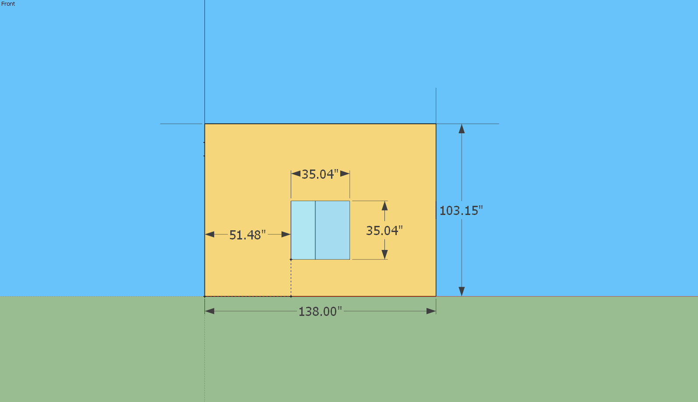
Three View for the CFD test room
N

Slide 6
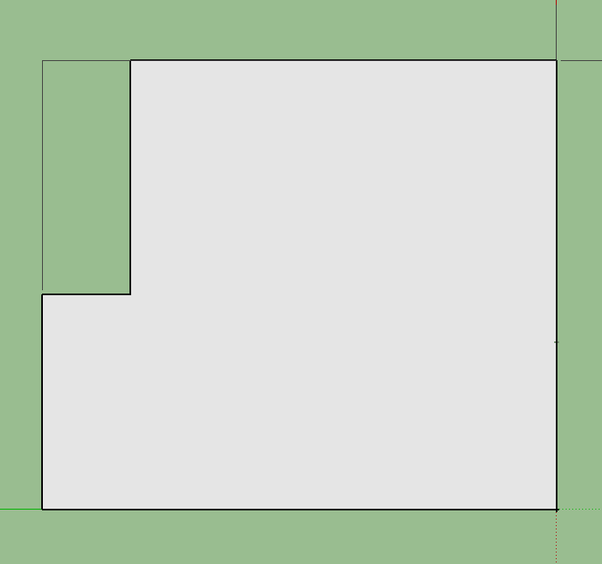

Top view
i: tree label
j: thermocouple label
N
T_2_j
26 in
T_1_j
T_i_1
20 in
70 in
T_i_2
T_5_j
T_i_3
T_4_j
T_i_4
18 in
T_3_j
T_i_5
Thermocouple tree
Diffuser
Thermocouple

Slide 7
Wall Surface Thermocouple
N
T_N
T_W
T_top
T_E
T_bot
69 in
65 in
T_S
Surface thermocouple

Slide 8
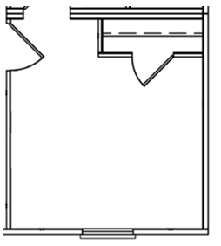
Test room information
Room Height: 103 in
Sensors:
The four surface thermocouples placed on the north, south, east, and west walls are at a height that is half of the room's height: 52.5 in
Diffuser:
6 in width, 12 in length
Located on the ceiling
flow rate: 80 CFM for each diffuser (160 CFM for both)
Discharge temp: 65F
Window
Size: 35 inches by 35 inches
Distance from each side to interior walls: 50 inches
Bottom edge of the window from the ground: 22 inches
Door
All the doors remained closed during the test
4
2
18 in
26 in
N
5
70 in
70 in
3
1
Thermocouple tree
Diffuser
Surface thermocouple

Slide 9
B.C. for the test room
Wall | Surface Thermocouple corresponding to each wall:
North Wall | T_N
West Wall | T_W
East Wall | T_E
South Wall | T_S
Ceiling | T_top
Floor Wall | T_bot

Slide 10
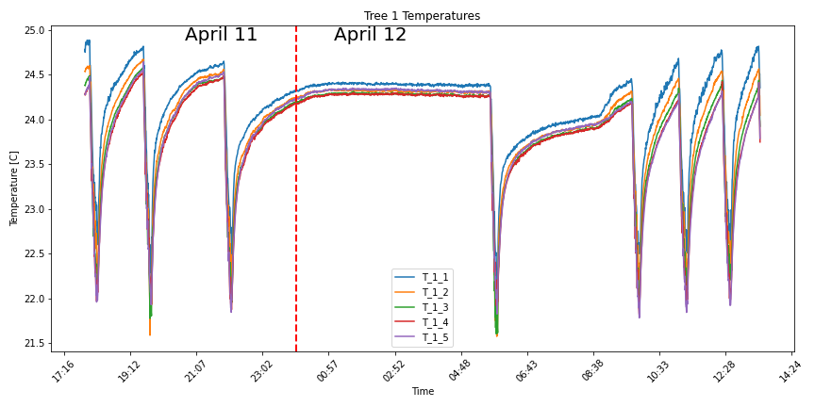
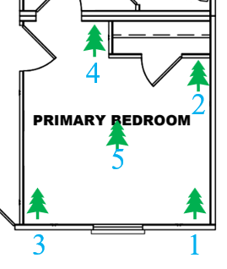
Tree 1 Temps
N
AC On to cool the indoor temperature

Slide 11
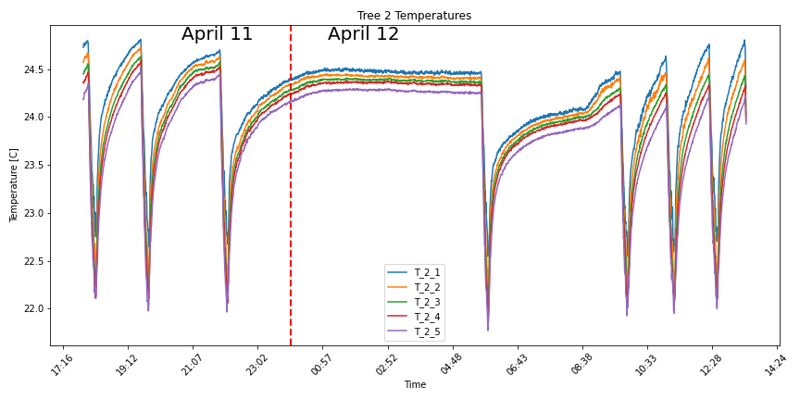
Tree 2 Temps
N

Slide 12
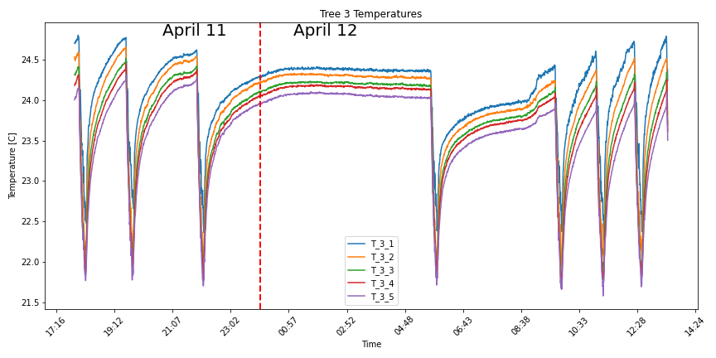
Tree 3 Temps
N

Slide 13
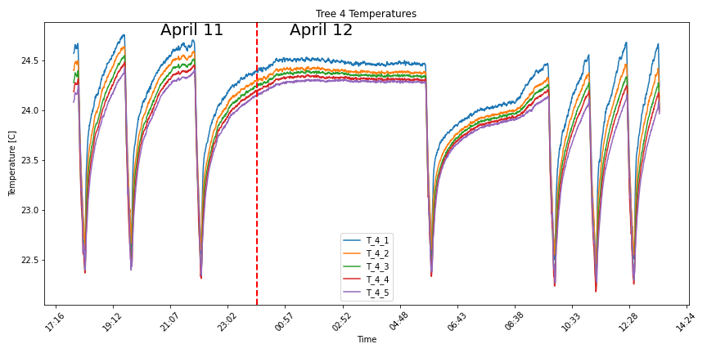
Tree 4 Temps
N

Slide 14
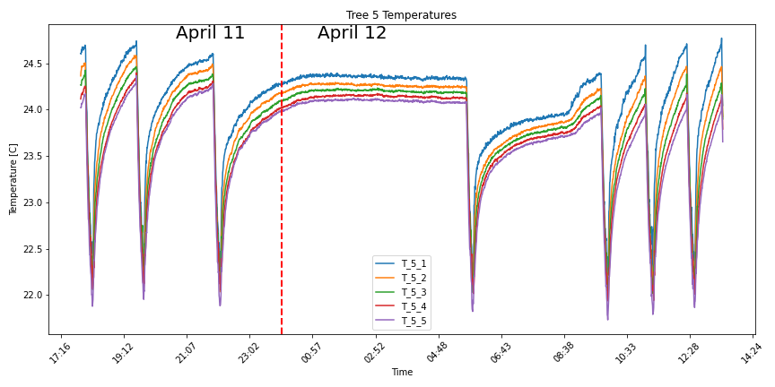
Tree 5 Temps
N

Slide 15
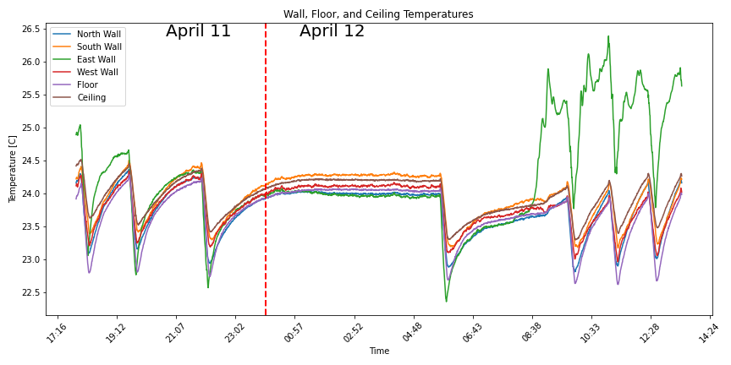
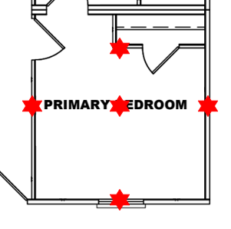
Surface thermocouples
N

Slide 16
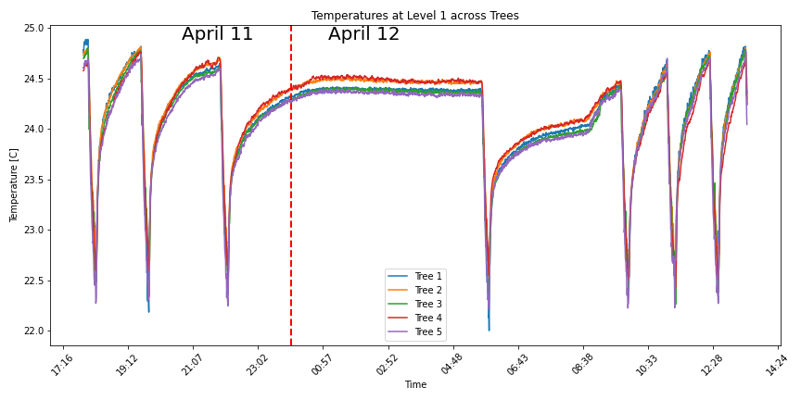

Temp at Level 1 across Trees

Slide 17
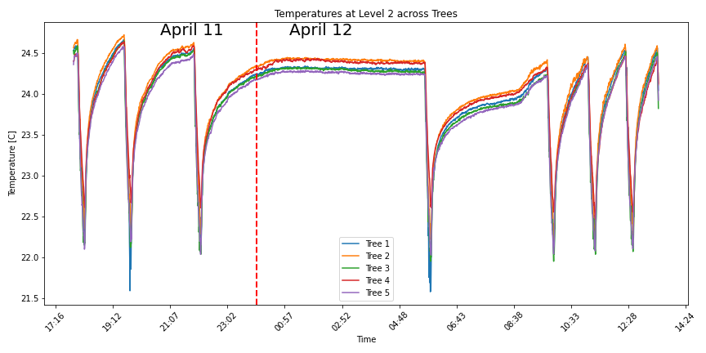
Temp at Level 2 across Trees

Slide 18
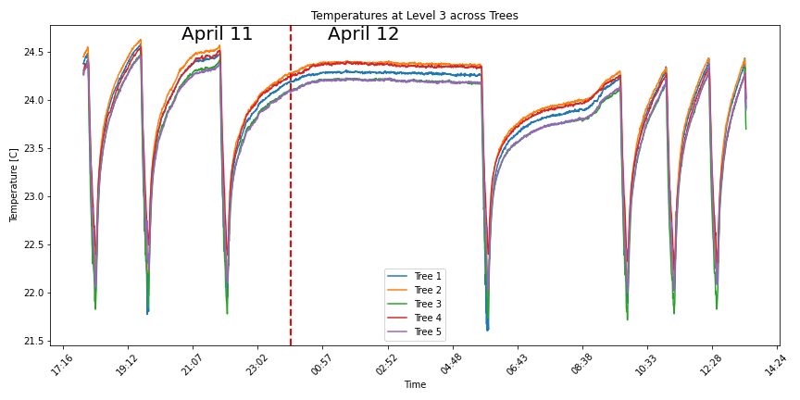
Temp at Level 3 across Trees

Slide 19
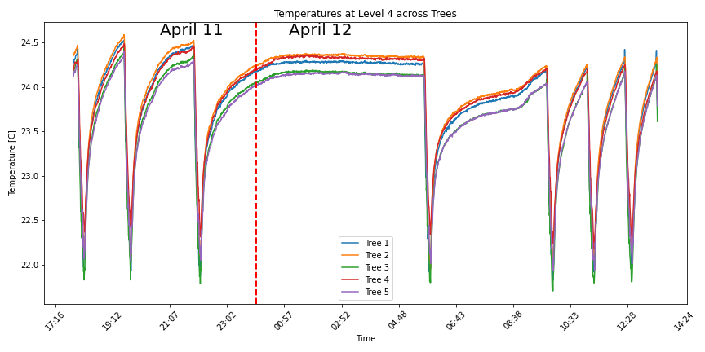
Temp at Level 4 across Trees

Slide 20
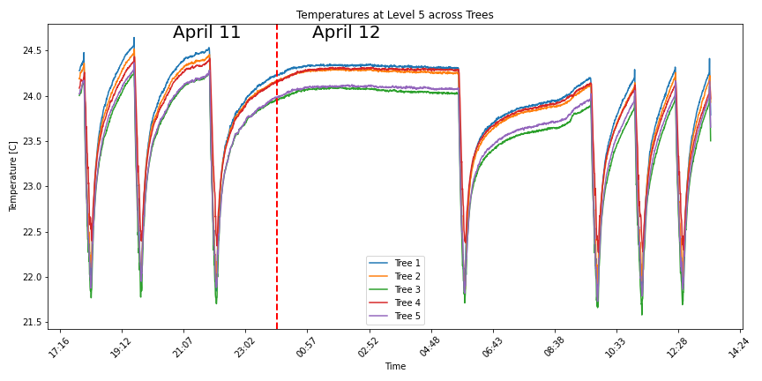
Temp at Level 5 across Trees

Slide 21
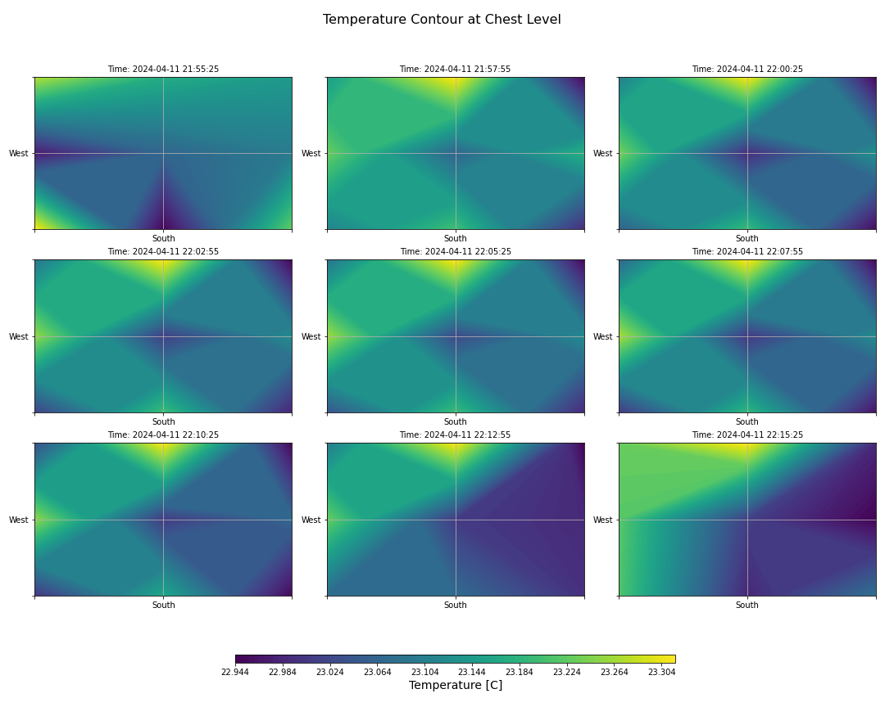
Chest Hight Temp Contour over AC ON/OFF

Slide 22
Thank You
For Your Attention!
wendell@tamu.edu
https://hvac.engr.tamu.edu/

Slide 23
Thermocouple Tree & Diffuser Location
4
2
5
3
1
Thermocouple tree
Diffuser

Slide 24
Thermocouple Tree
T_i_1
20 in
T_4_j
T_i_2
i: tree label
j: thermocouple label
T_2_j
T_i_3
69 in
N
T_5_j
T_i_4
T_i_5
65 in
T_3_j
T_1_j
Thermocouple

Slide 25
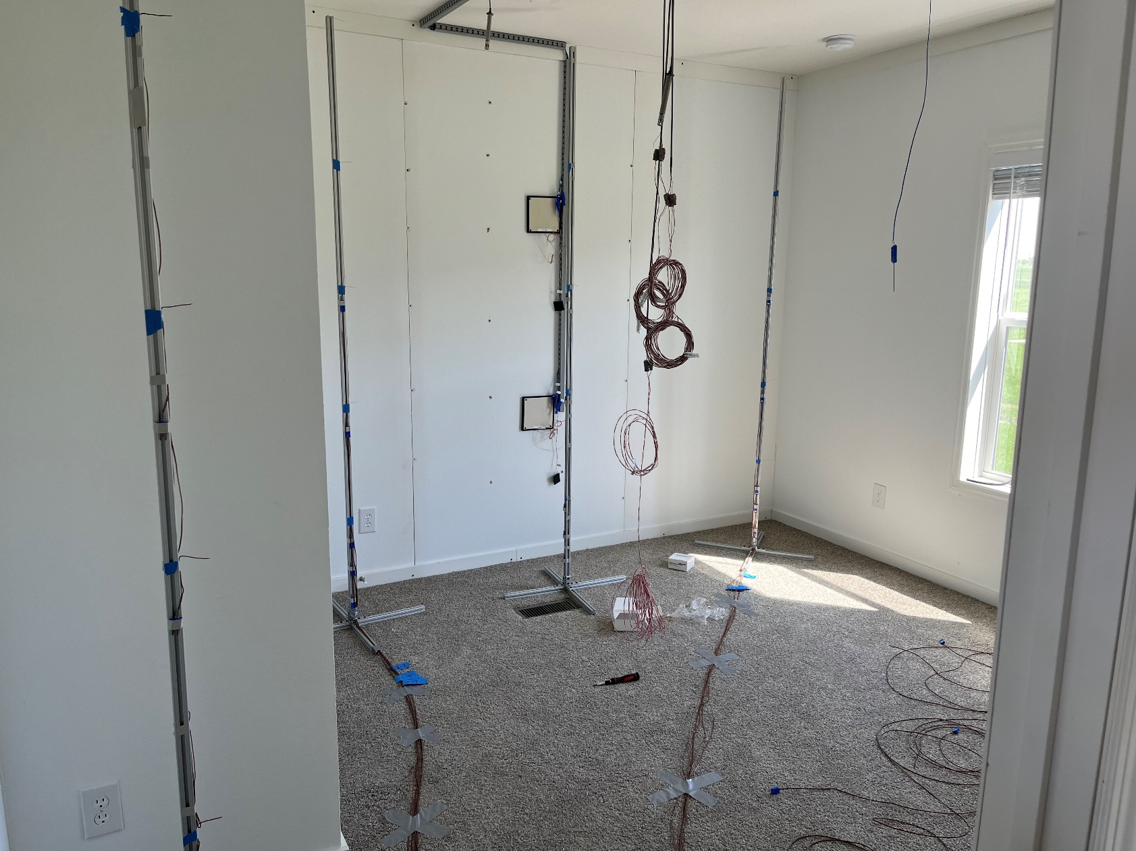
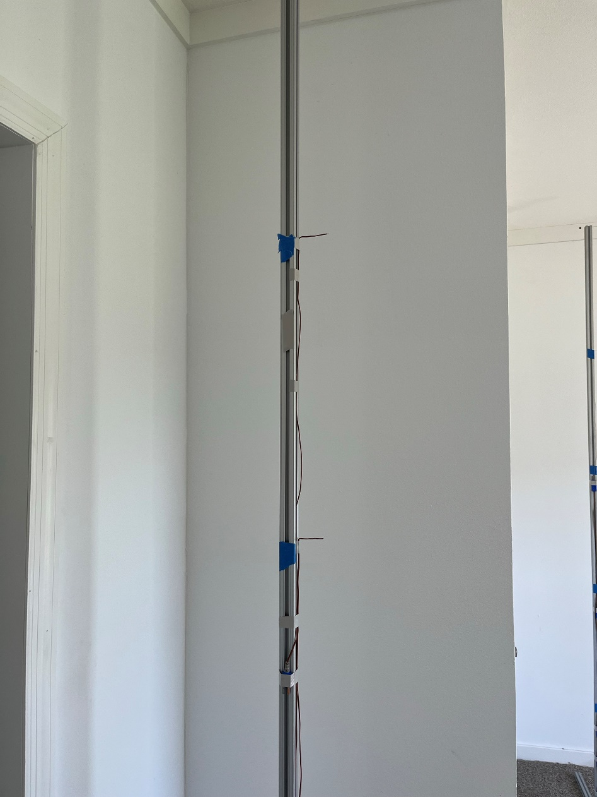
Thermocouple tree
20 in
Thermocouple

Slide 26
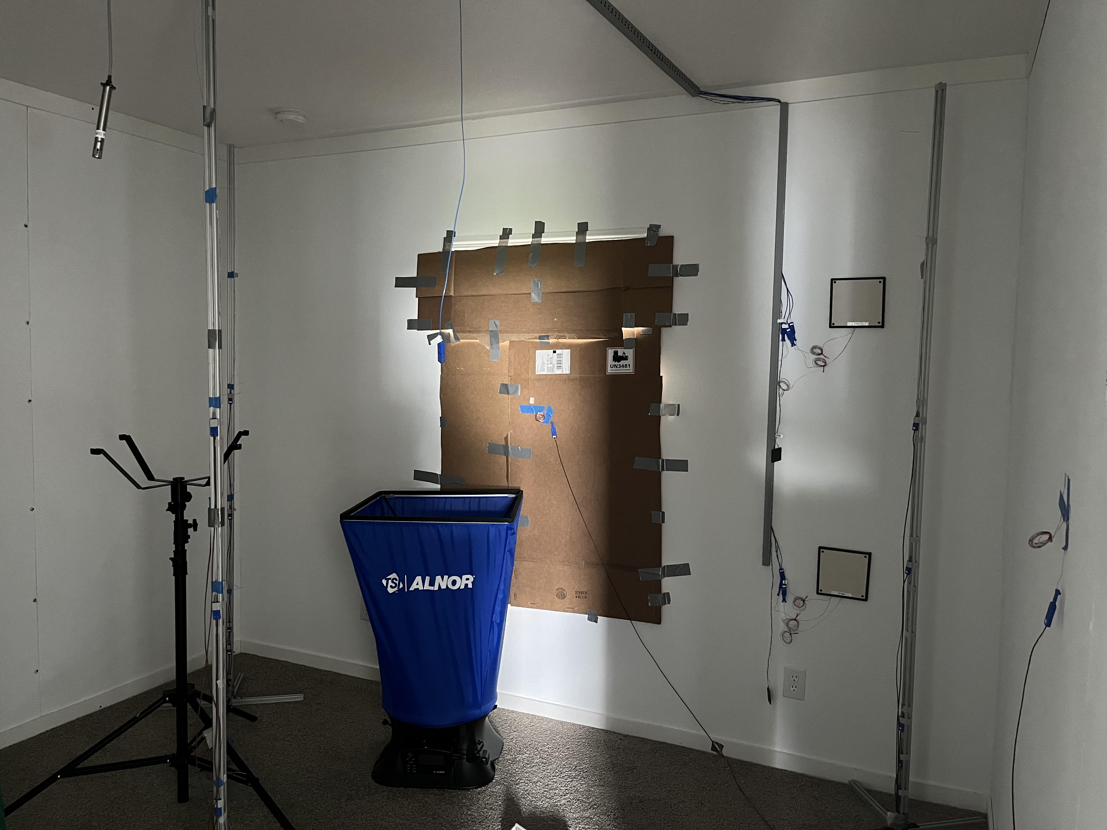
Window Condition
We cover the window using cardboard

